Slide 1
Assignment 1 Part 2 Setting up Test Environment
Installing Virtual Machine software.
Setting up Virtual Machine.
Install QEMU.
Assemble and Test Bootloader.

Slide 2
Purpose of Assignment Part 2
The overall class goal is to examine a practical Operating System from boot to operating a command line interface.
The assignment goal is to set up the environment for emulating a 386 processor-based computer and learning the bootloader process, examining and executing a very simple assembly language boot loader.

Slide 3
Assignment Note
This assignment will ask for a screenshot (or image) and a modified copy of print.asm, review the last slide carefully.
QEMU will be a virtual machine within a virtual machine, both machines can sometimes capture the mouse to release the mouse the default key should be Ctrl-Alt for QEMU and the right CTRL key for Oracle VM (though I have mouse capture turned off for my Oracle VM settings). When you run QEMU you can set a flag to turn off mouse capture, see qemu-system-i386 –help for options (there are very many of them).

Slide 4
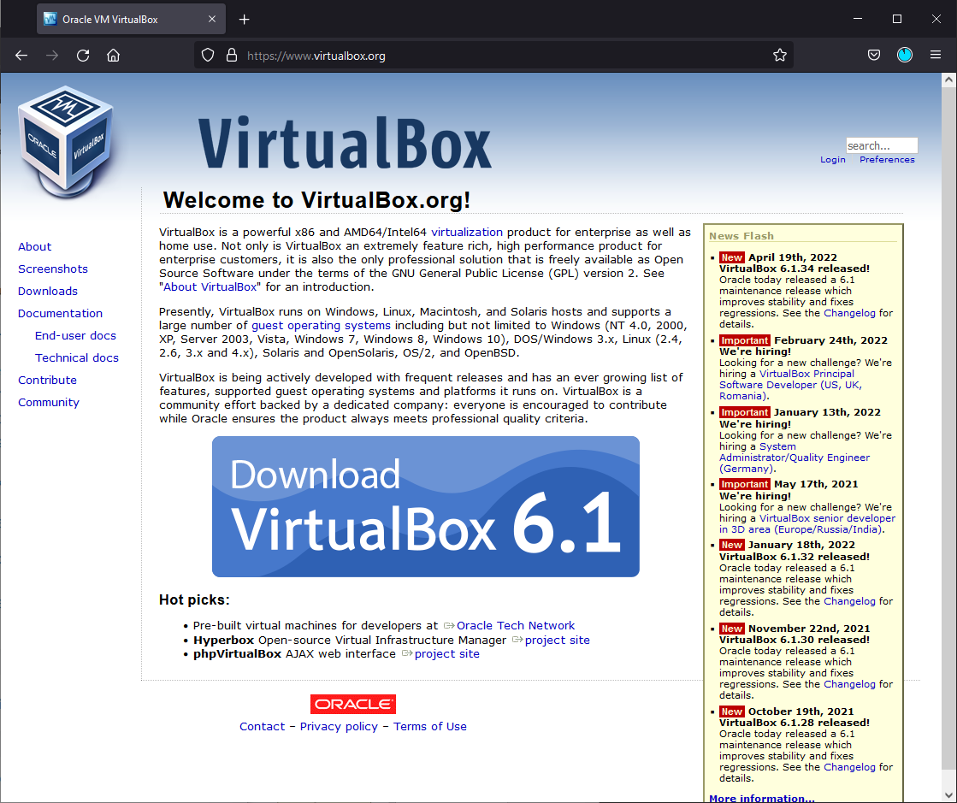
Oracle VM
https://www.virtualbox.org/
Download the current version ,v6.1 as of this writing, appropriate for your host hardware and OS.

Slide 5
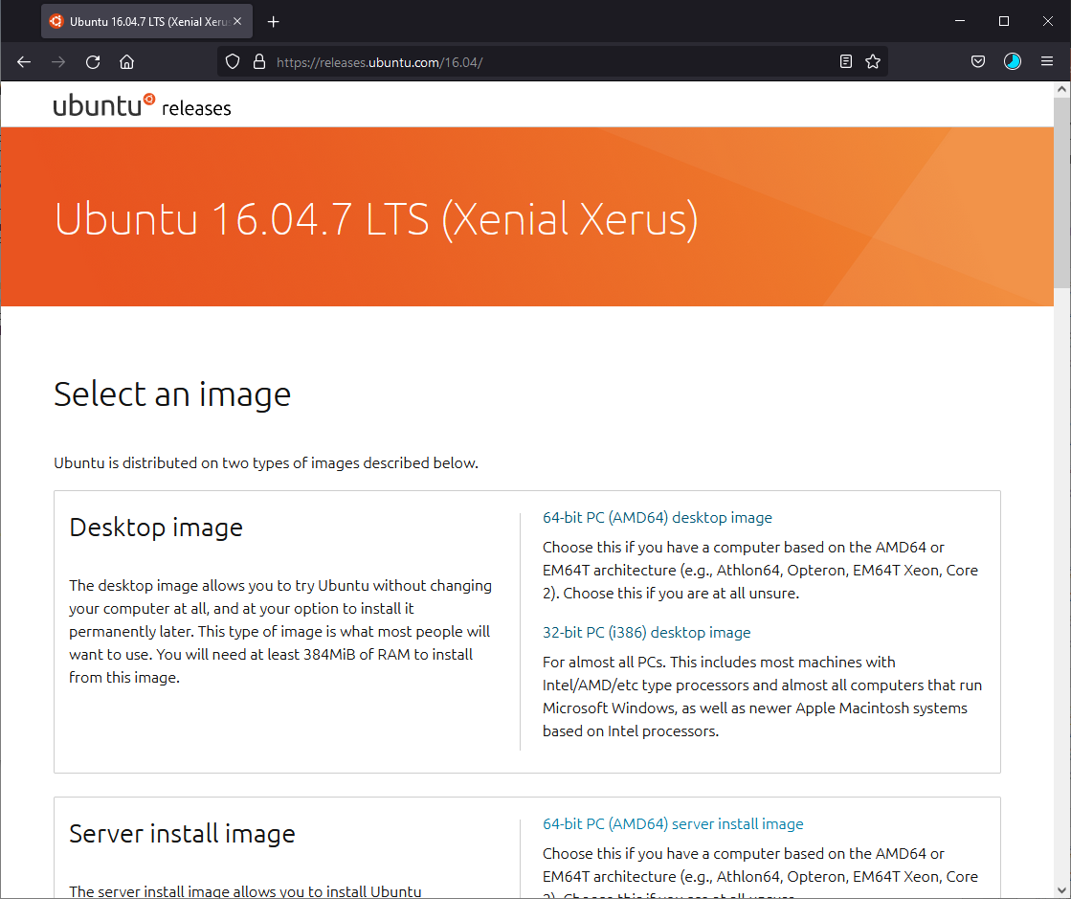
Linux host operating system iso image.
https://releases.ubuntu.com/16.04/
https://releases.ubuntu.com/18.04/
Running QEMU under windows does work but is somewhat difficult to setup so it is preferred to use a Linux environment.
Get the appropriate desktop image for your host hardware and OS.
e.g., the 64-bit PC(AMD64) desktop image
You can use other OS distributions like Centos, Arch, KDE, FreeBSD so long as you can install on VM and run QEMU on them.

Slide 6

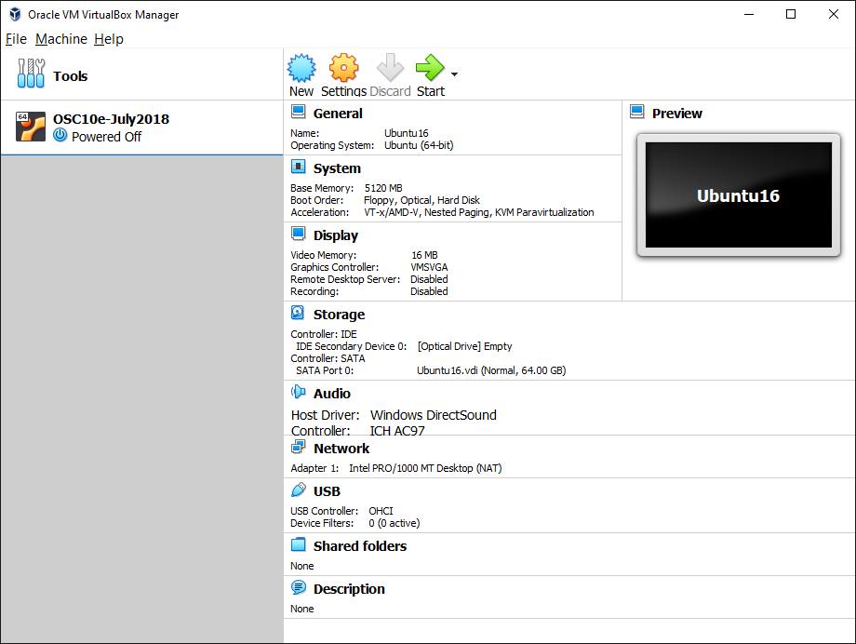
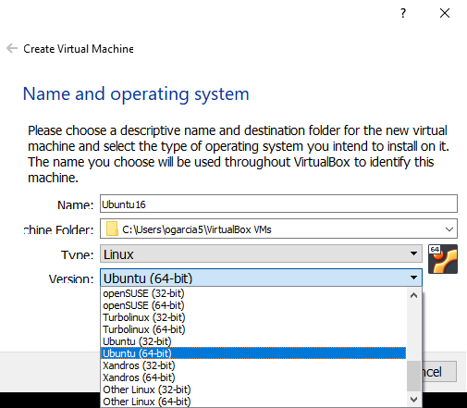
Set up VM Host
Create a new VM to match iso image.

Slide 7
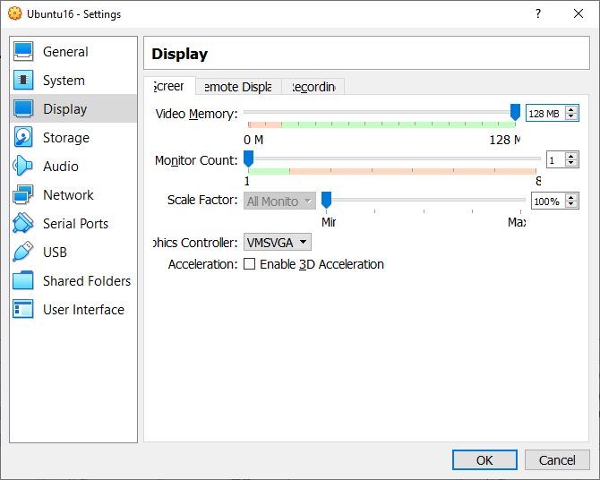

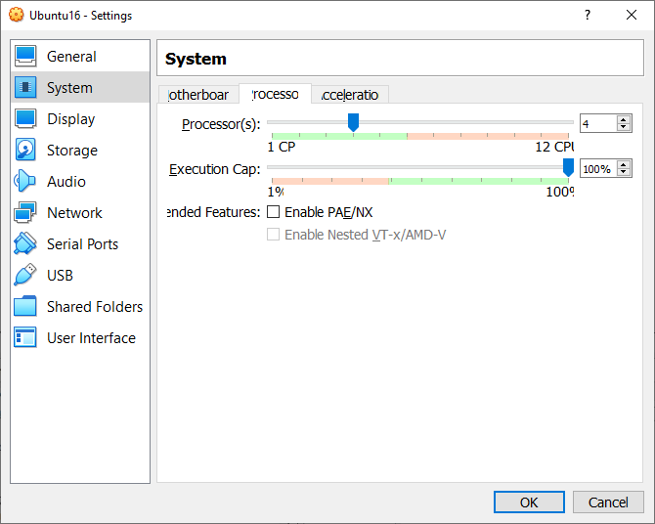
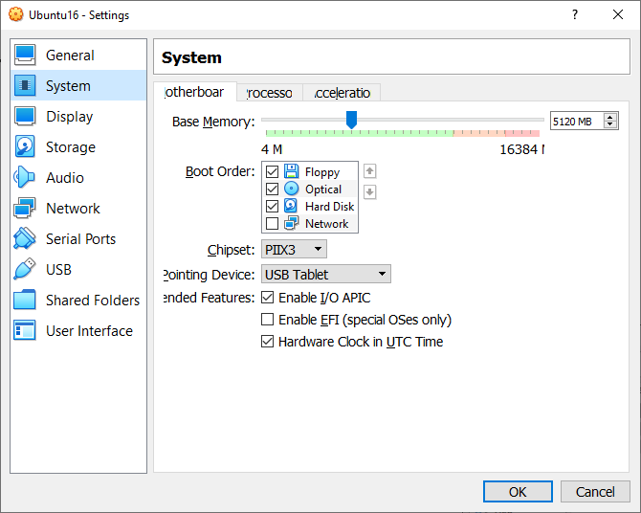
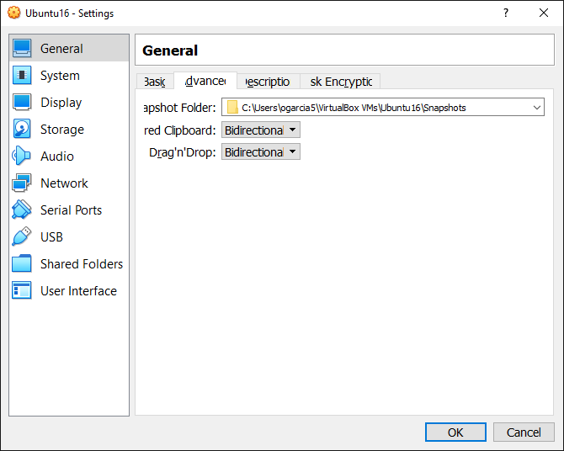
Set up VM Host
Set Video memory to max and
If GPU check 3D Acceleration
Configure Settings for VM
Ubuntu is pretty heavy on resources, e.g. Arch requires 2048Mb and much less
Virtual hard drive space. Goal here, though, is uniformity to make sure it runs
for everyone.
Share text and objects
Between host and VM
At least 2 cores
At least 4096 Mb

Slide 8
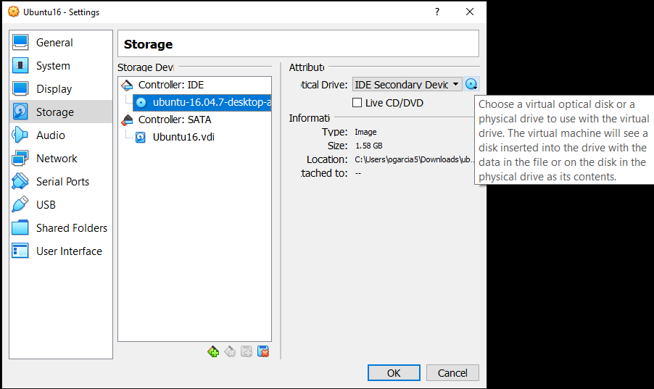
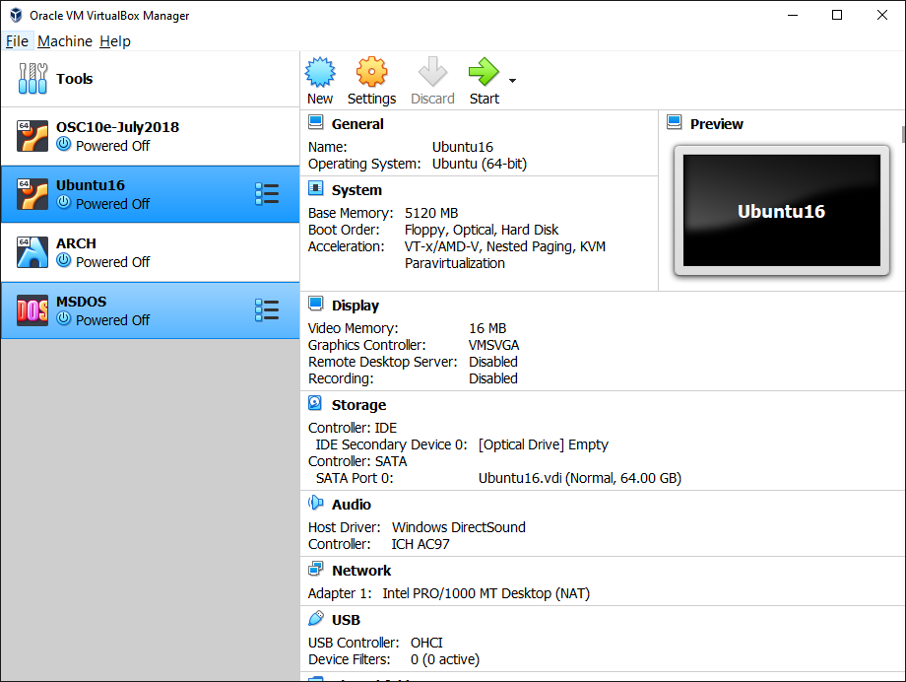
Set up VM Host
Place ISO image into VM DVD drive
Double click VM to start.

Slide 9
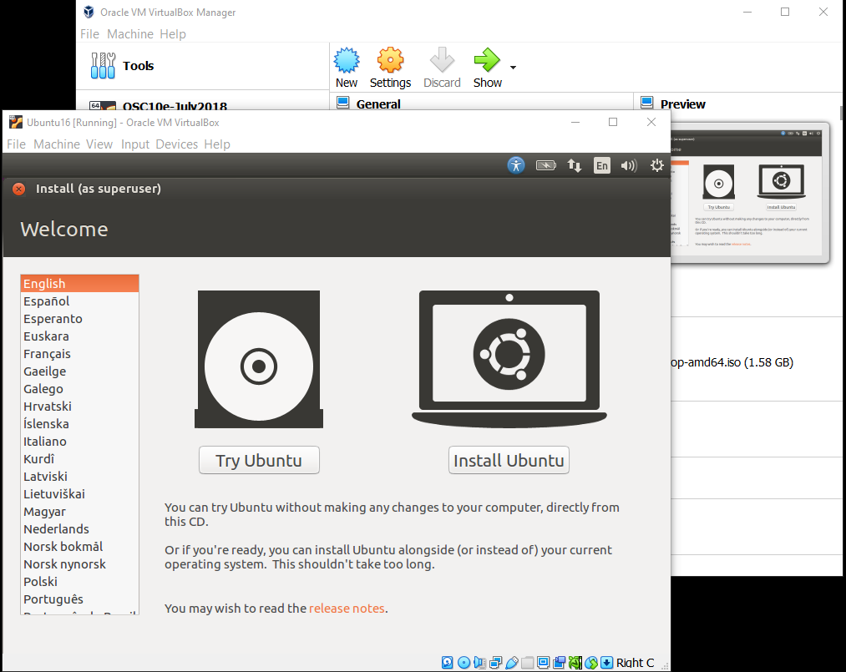
Install VM OS
Ubuntu (even old v16) is a rather heavy and laden distribution.
Alternatively you can install ARCH linux (which has QEMU 7.0 natively installed already) or any of the other light weight distributions so long as QEMU works with them (may need to install gtk and compiler toolsets in addition to nasm)

Slide 10
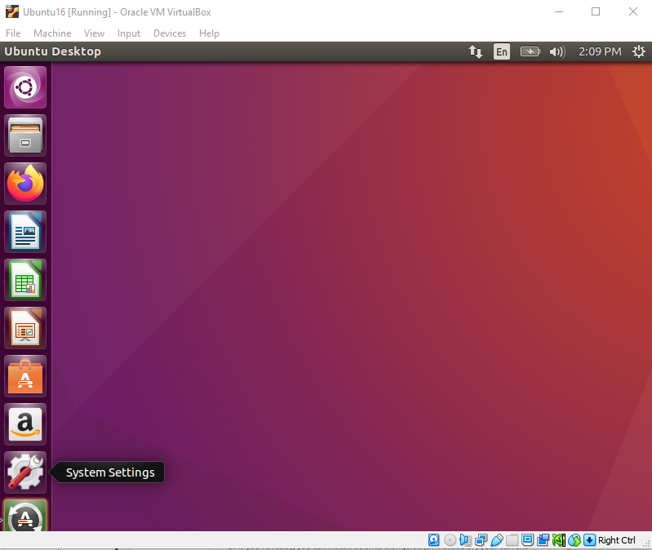
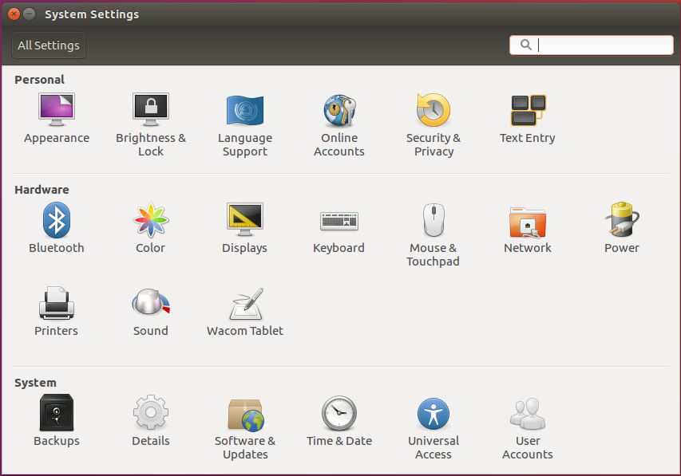
Install VM OS
Select System Settings / Displays to change display
Resolution to something less cramped.

Slide 11
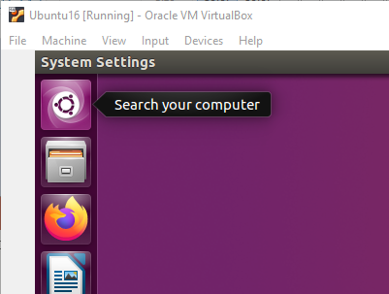
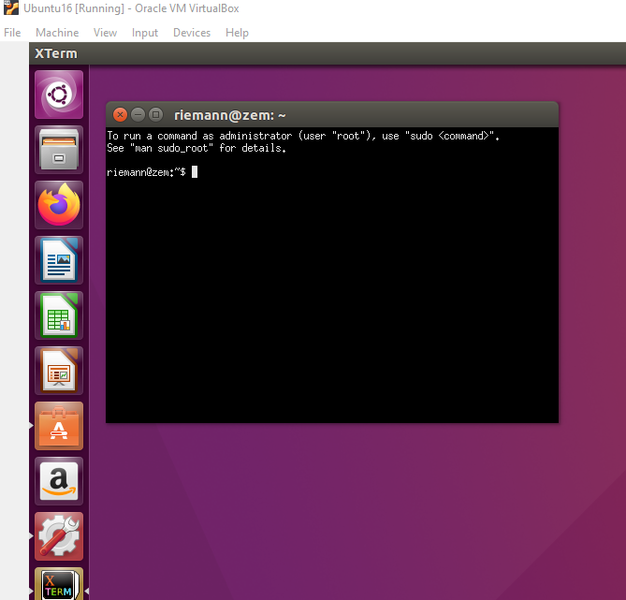
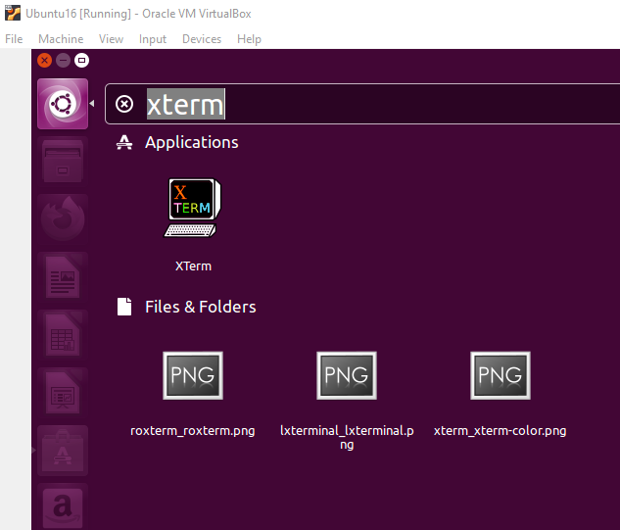
Setting up QEMU
Run XTerm

Slide 12
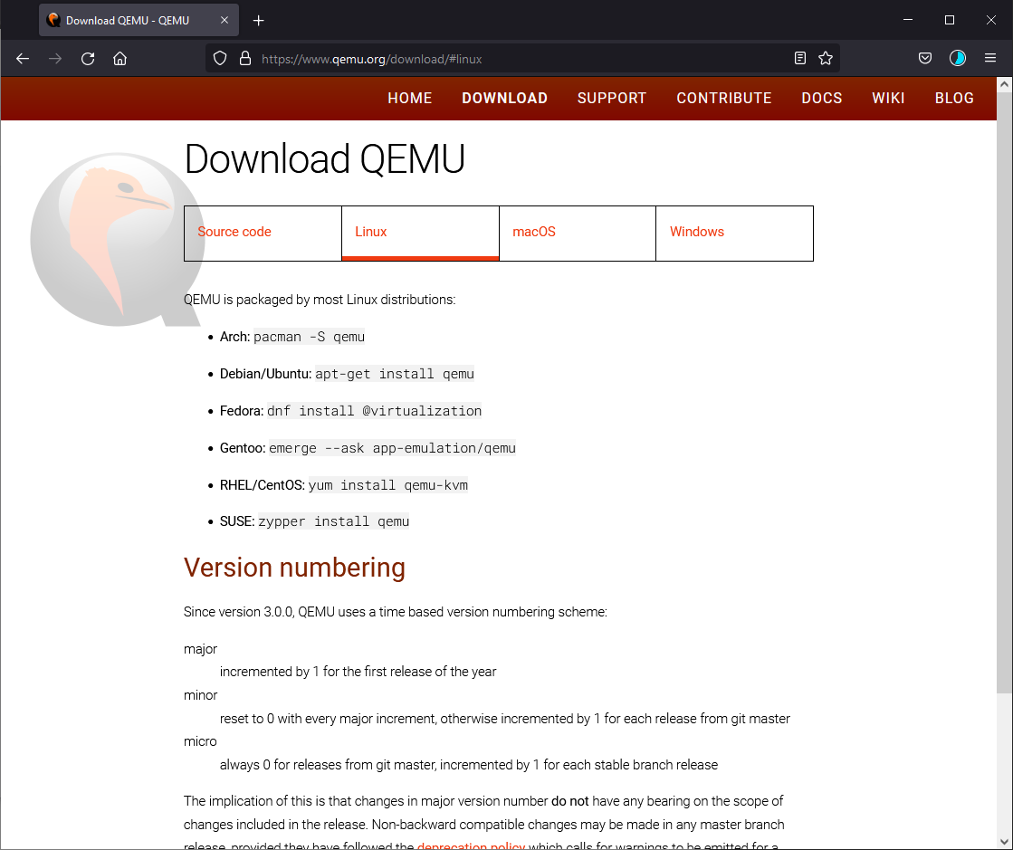
QEMU
Install QEMU in virtual machine.
e.g. sudo apt-get install qemu

Slide 13
Setting up QEMU
In Xterm CLI run the following commands:
sudo apt-get update
(the first time it will prompt for your password, you should be default in sudo group; just enter your password again)
sudo apt-get upgrade
sudo apt-get dist-upgrade
sudo apt-get install nasm
sudo apt-get install qemu

Slide 14
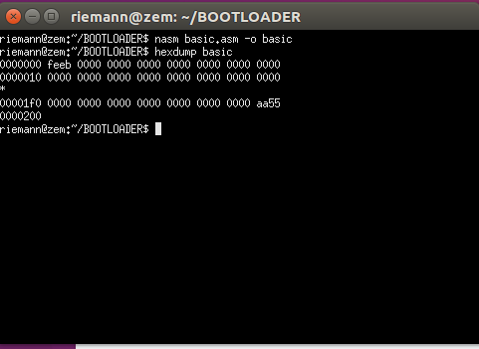
The bootloader
This is a basic bootloader for a BIOS based system:
; A simple boot sector program that loops forever
loop:
jmp loop
; the line below fills in remainder with zeros up to 510 bytes
times 510-($-$$) db 0
; 386 CPUs required this number at end to recognize as bootsector
dw 0xaa55
; Total Size is 512 bytes with only two bytes for our bootloader code eb -2
basic.asm
The hexdump of this loader looks like this (image right):

Slide 15
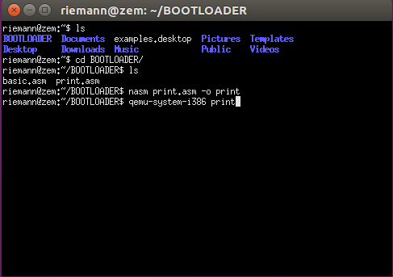
Testing a boot loader
Once the environment is set up download the print.asm file from D2L and save it in your home directory in the environment.
You can run Firefox from the VM (should be version 88 which is old but still works with KSU D2L as of 06/08/2022) to retrieve print.asm or you can type in the code using an editor and storing it as an .asm file. “gedit” and “vim” are to native text editors:
gedit print.asm & (the & puts it in background) from the Xterm CLI will bring up an editor window much like “notepad” for windows.
In Xterm cd (change directory) to print.asm is stored and assemble it with
nasm print.asm –o print
Then use QEMU to load the bootloader binary “print”
qemu-system-i386 print

Slide 16
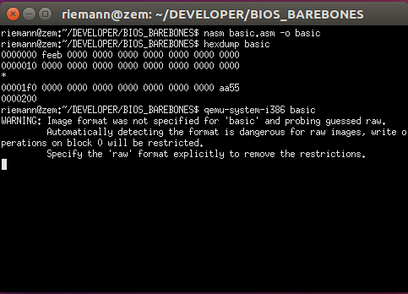
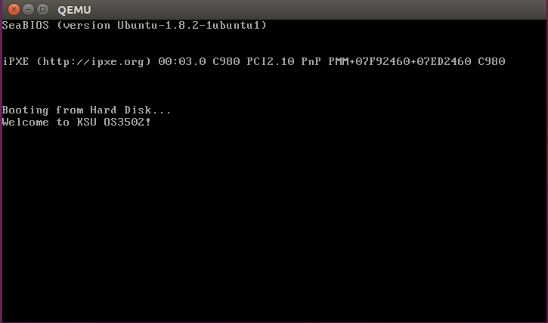
Running the Bootloader
Success!
If you see a new window like this, bootloader was successful.

Slide 17
Modify the bootloader
Edit print.asm to change the message to something else. This means changing the ‘W’, ‘e’, ‘l’… etc. characters one at a time before int 10h instruction.
Assemble (with nasm) the modified print.asm file.
Submit a screenshot with the modified result and the modified print.asm text in your Word HW submission document for parts I and II.
NOTE: A QEMU virtual machine is running within the ORACLE VM-WARE virtual machine. There are two mouse captures that could take effect.
If you click inside the QEMU screen it will trap the mouse. To release press CTRL-ALT.
If your mouse it captured by the VM press the right CTRL key (the host key) to release it.
To take a screenshot you may have to click outside the Virtual-Machine and hit Print-Screen or its equivalent or take a photo. Open the save image in an editor and crop the relevant parts out. Don’t submit the entire screen; I don’t want to know what is on your Desktop (security and privacy).

